Slide 1
BUILDING
BETTER
FIGURES

Slide 2

WHAT FIGURES DO
COMMUNICATE IDEAS
UNITE CONCEPTS
ENTERTAIN

Slide 3

GOOD FIGURES
TELL THE WHOLE STORY
EASILY INTERPRETABLE
PLEASE THE EYES

Slide 4
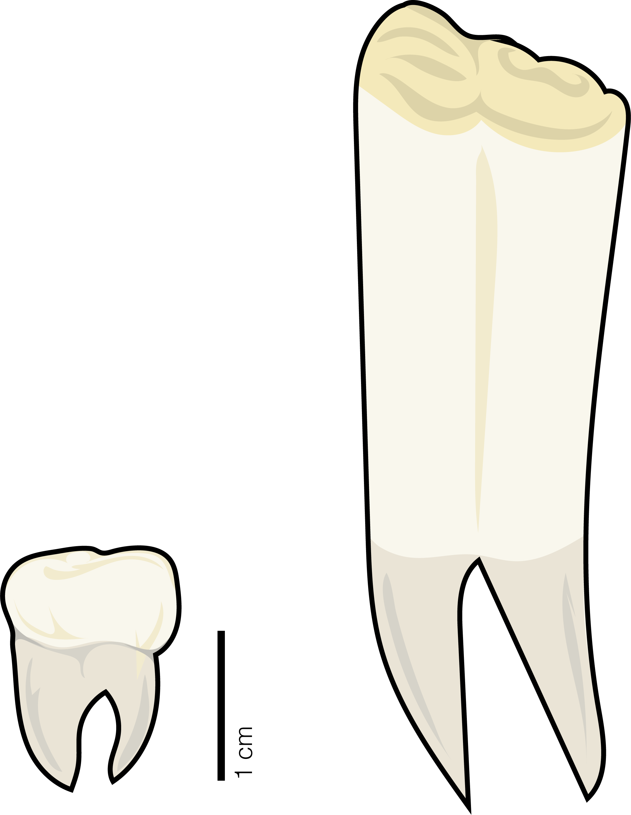


PAPER
FIGURES
TALK
FIGURES
# SPECIES
POSTER
FIGURES
HABITAT TYPE

Slide 5
PAPER
FIGURES
MUST
STAND ON
THEIR OWN
# SPECIES
HABITAT TYPE

Slide 6
MOSTLY
STAND ON
THEIR OWN
POSTER
FIGURES

Slide 7
TALK
FIGURES
CAN
RELY ON
YOUR TALK

Slide 8
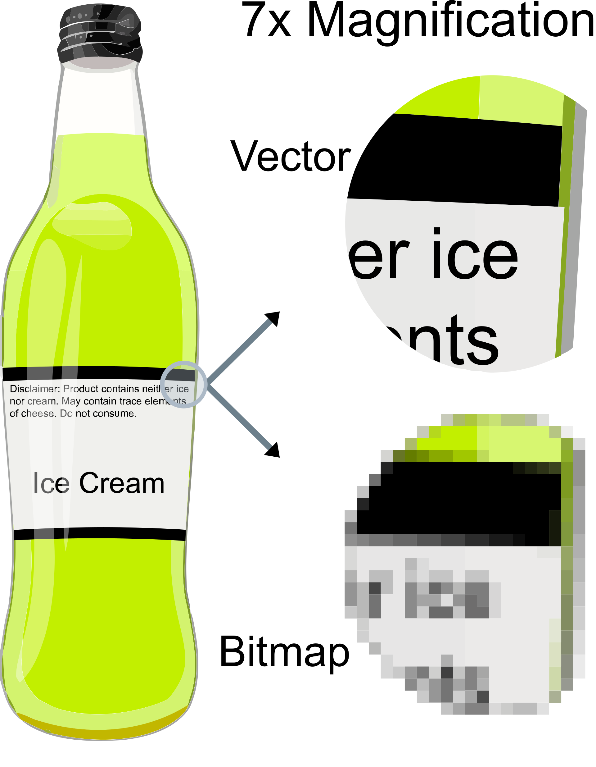
FILE TYPES
RASTER
PNG
JPEG
GIF
VECTOR
SVG
PDF
EPS

Slide 9
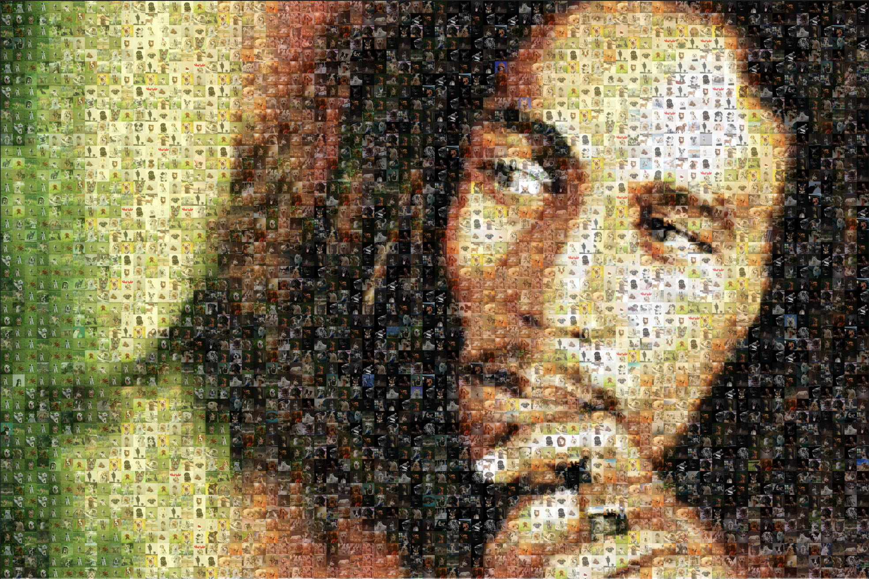
RASTA RASTER

Slide 10
AESTHETIC PRINCIPLES
SHAPE
•
SPACE
•
COLOR
BALANCE
•
MOVEMENT
•
PROPORTIONS

Slide 11
S H A P E
CAN I USE SHAPE TO CONVEY AN IDEA?
•
WHAT SHAPE SUITS MY PRESENTATION?
•
CAN SHAPE CONTRIBUTE TO FLOW?

Slide 12
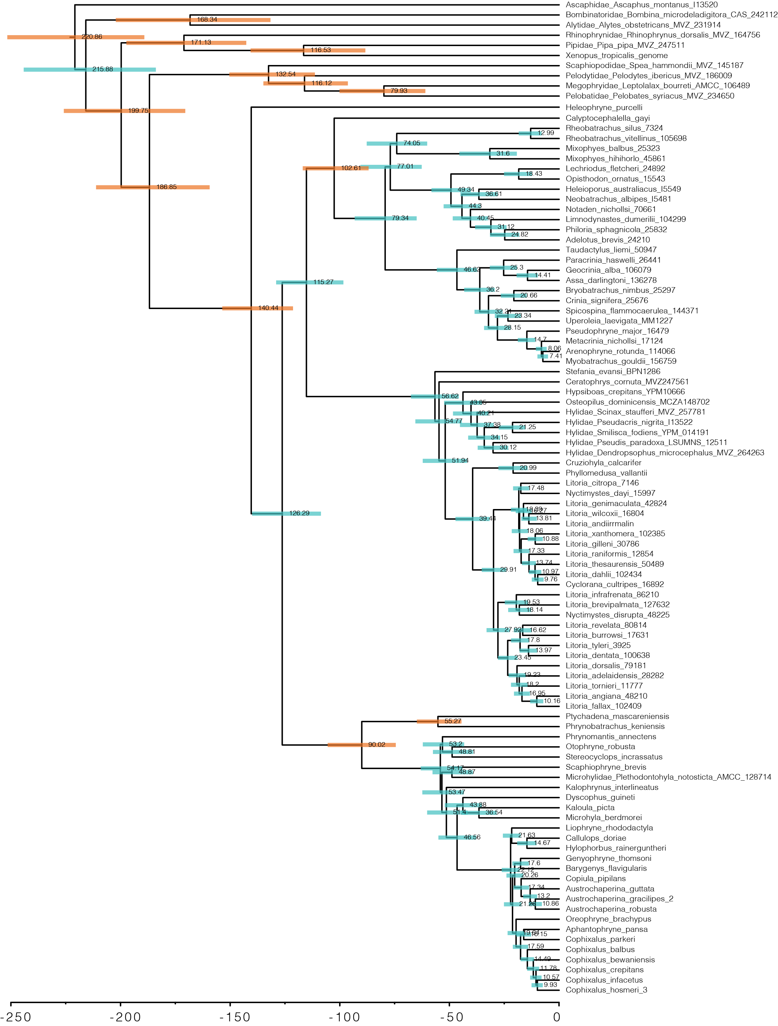
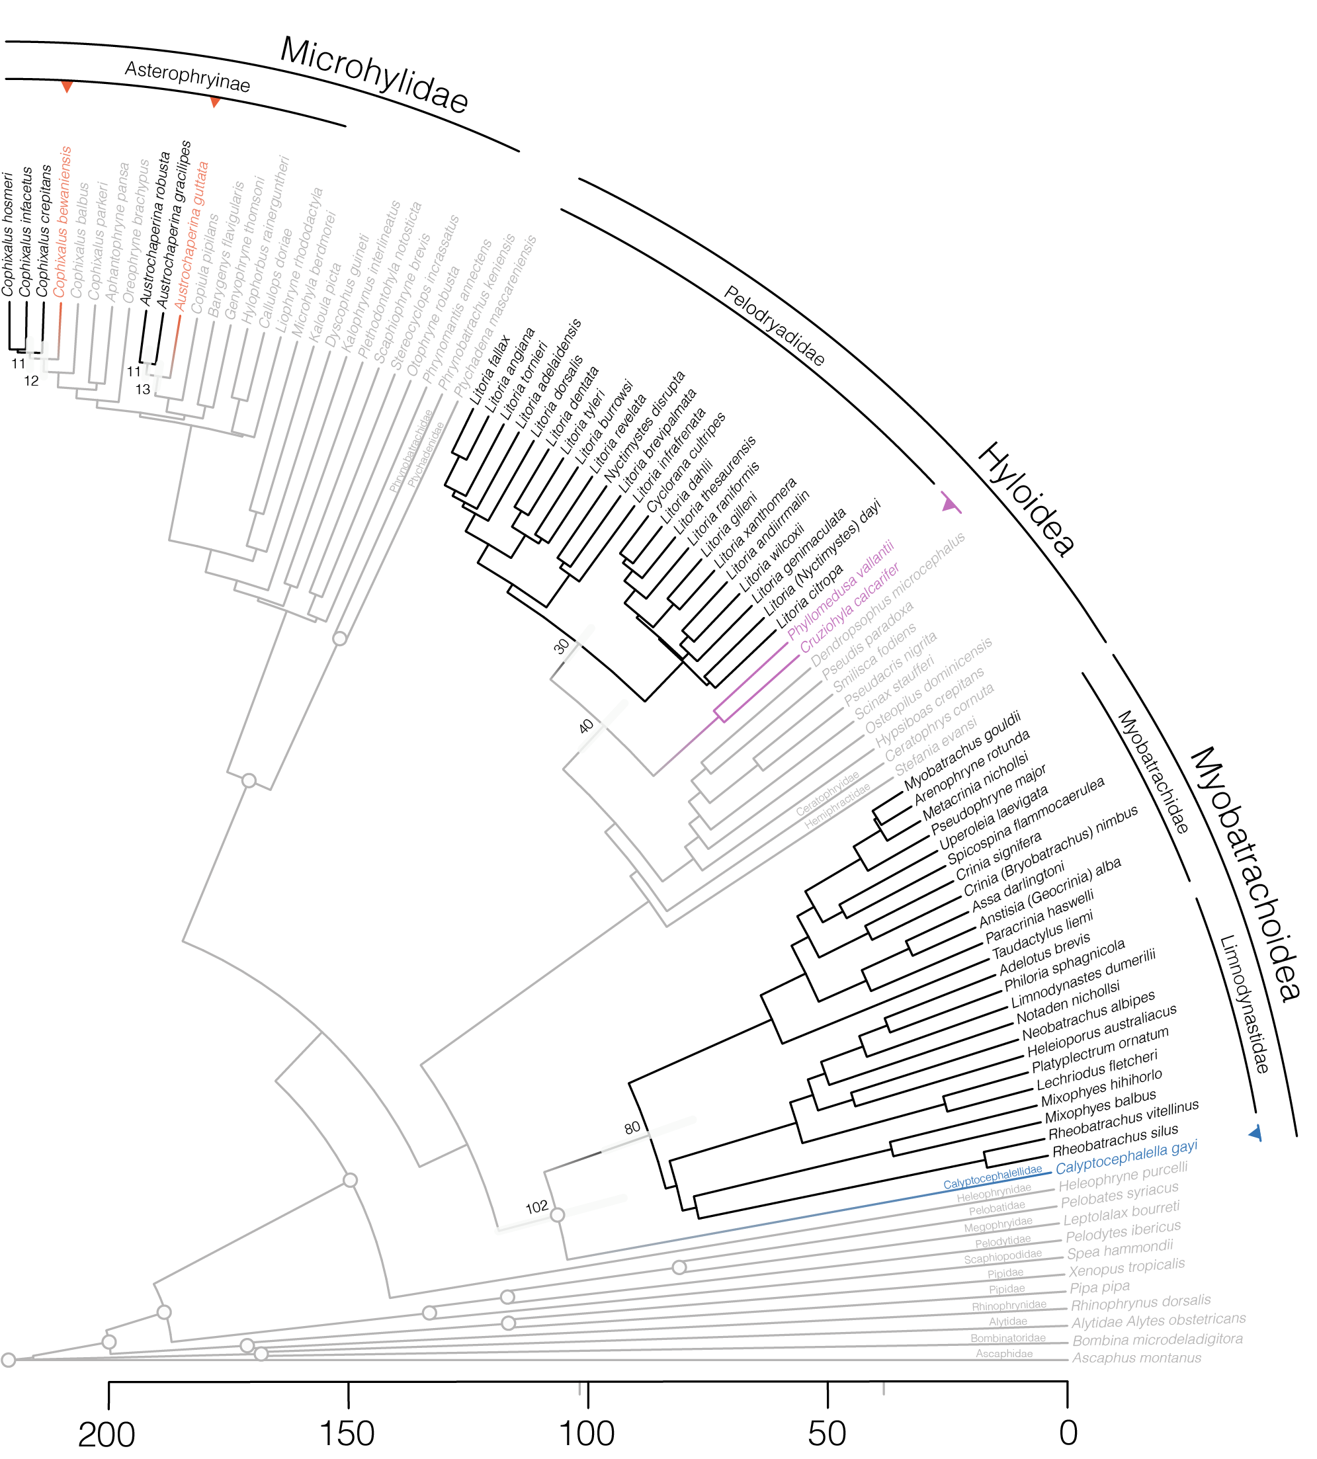

Slide 13
S P C E A
DO ELEMENTS HAVE ROOM?
•
IS MY FIGURE CRAMPED?
•
ARE DIFFERENT IDEAS DELIMITED?
•
IS THERE TOO MUCH SPACE?

Slide 14
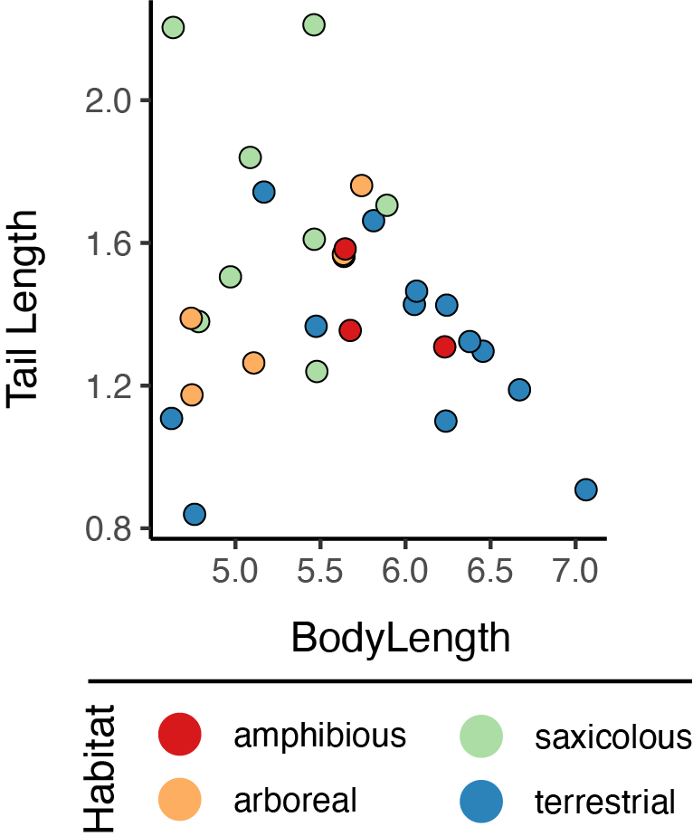
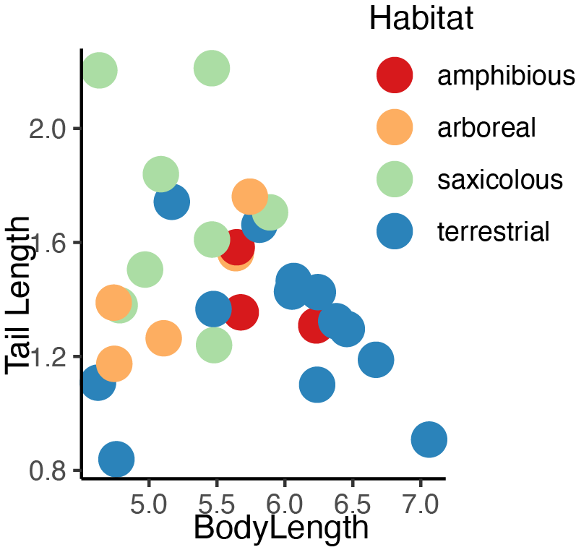

Slide 15
C O L O R
HUE
•
SATURATION
•
SHADE
•
OPACITY/TRANSPARENCY

Slide 16
C O L O R
COLOR FOR EMPHASIS
•
COLOR TO DISTINGUISH
•
COLOR FOR AESTHETICS

Slide 17
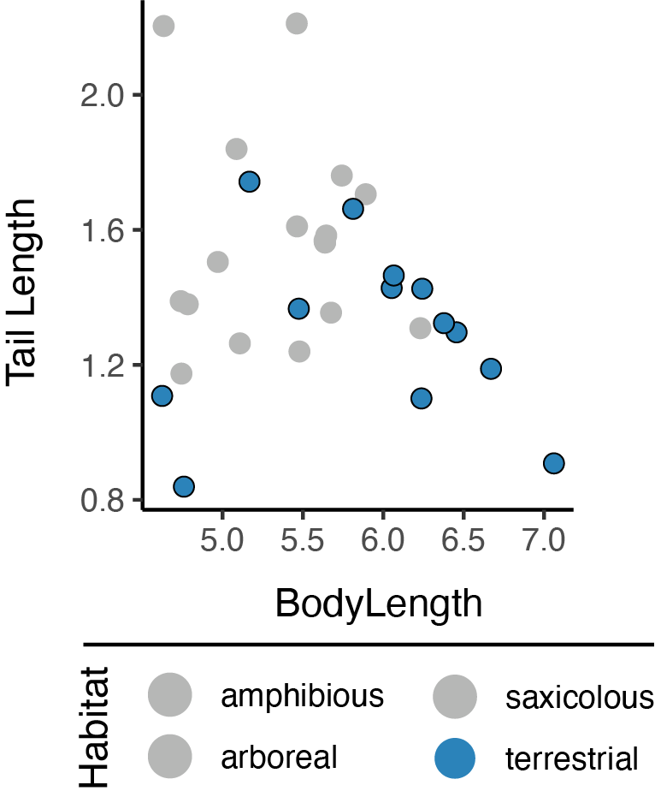

Slide 18
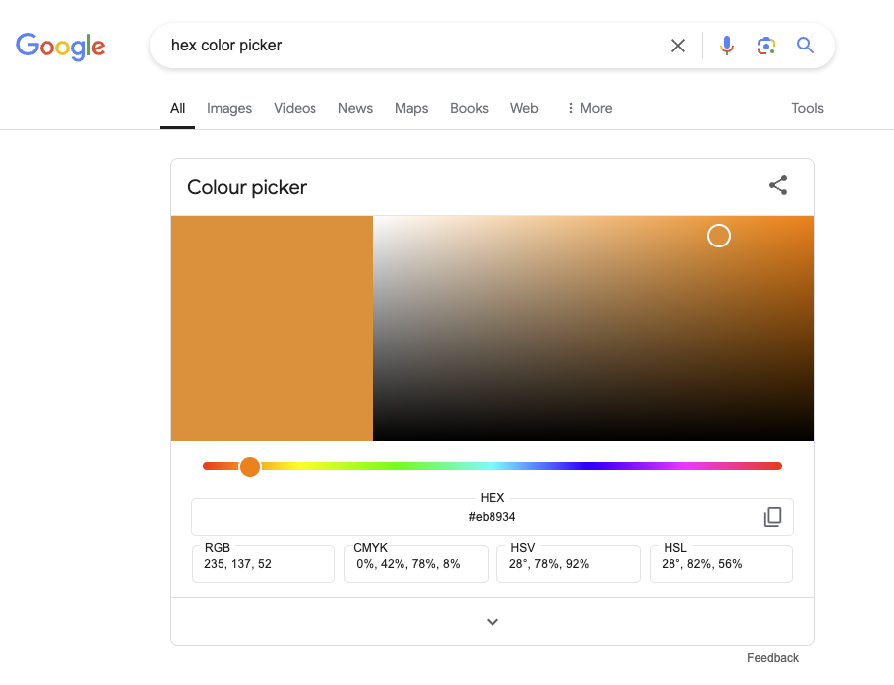
HEX COLOR PICKER

Slide 19
← MOVEMENT →
IS THERE A NARRATIVE?
•
AM I LEADING THE VIEWER?
•
SINGLE OR MULTIPART FIGURE?

Slide 20
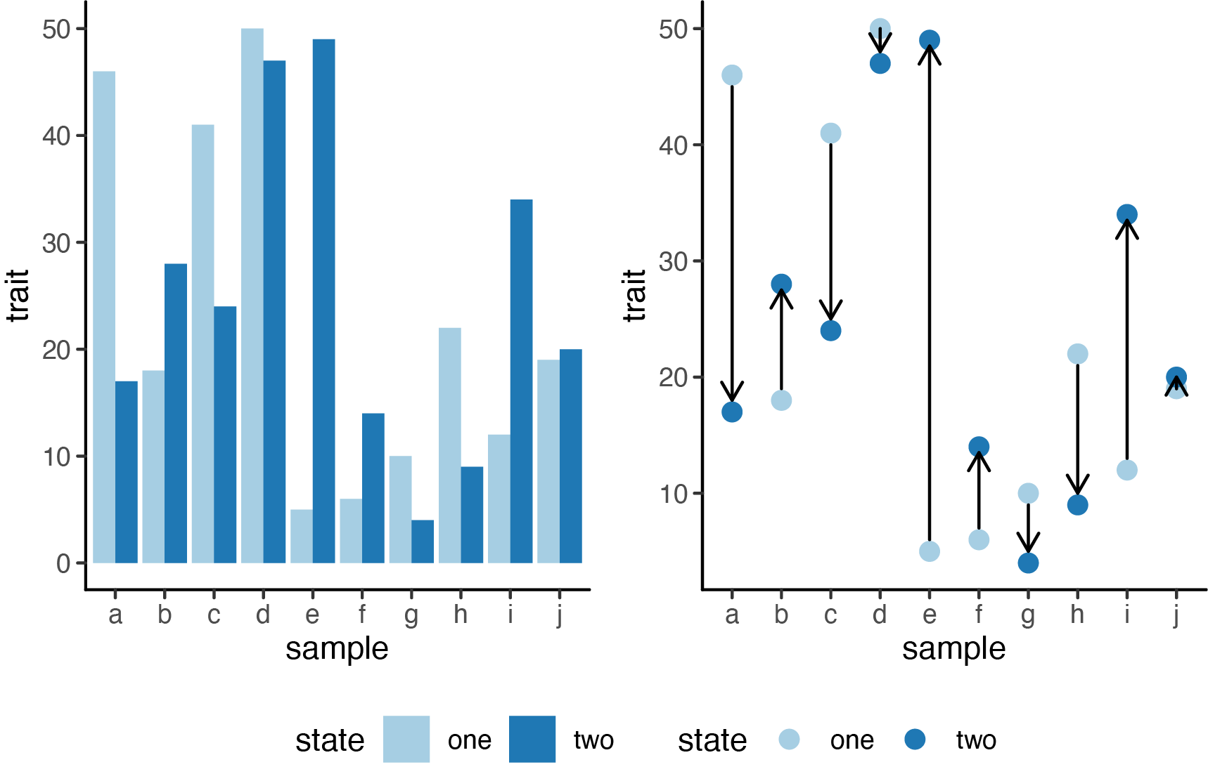

Slide 21
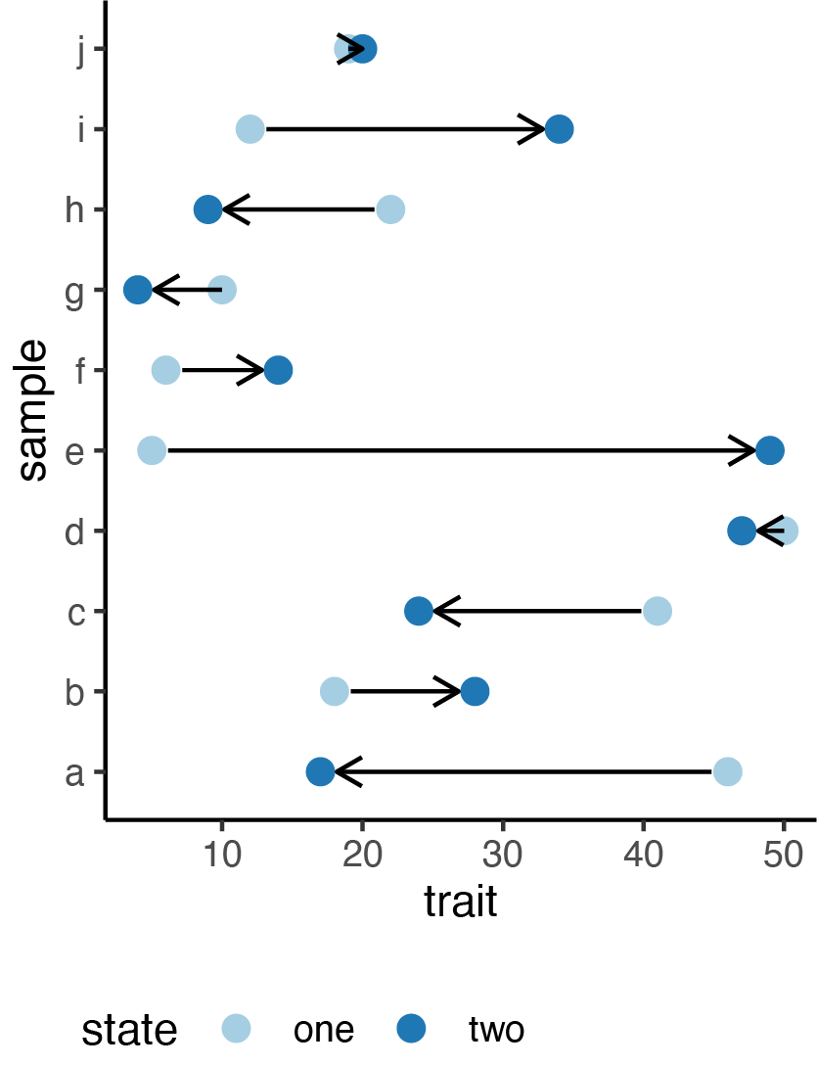

Slide 22
PROPORTIONS
DO PROPORTIONS MATTER? (PCA)
•
CAN I CONVEY IMPORTANCE?
•
SOME PORPORTIONS DON’T WORK

Slide 23
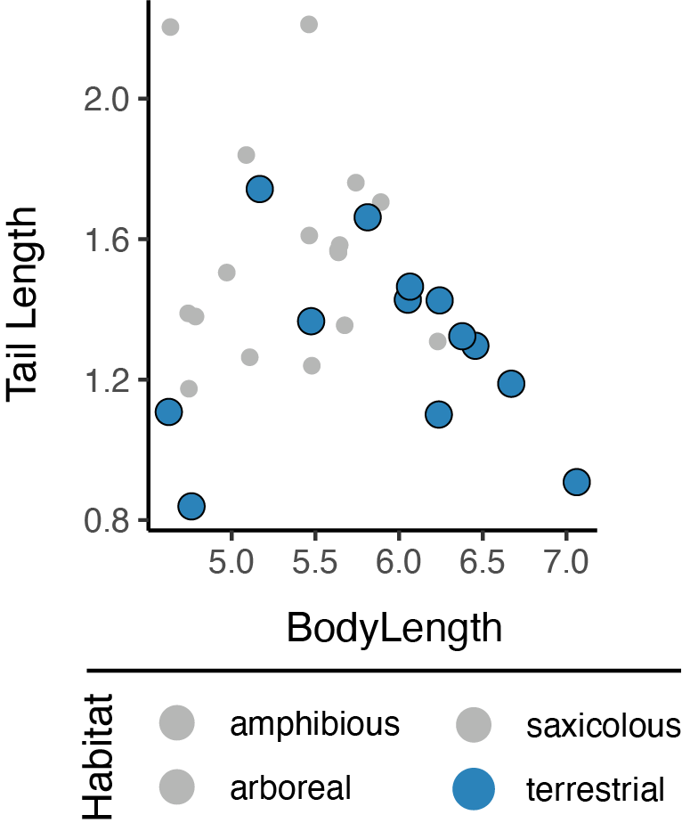

Slide 24
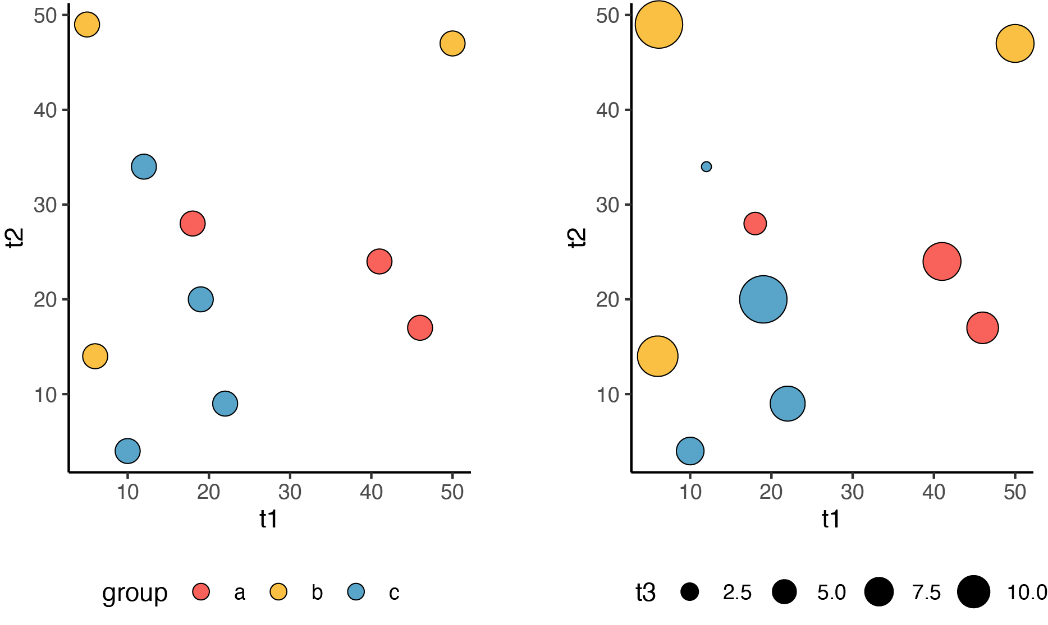

Slide 25
TEXT AND FONTS
SERIF VS. NON-SERIF
•
PLAYFUL VS. CONSERVATIVE
•
TEXT TO MAKE A POINT

Slide 26
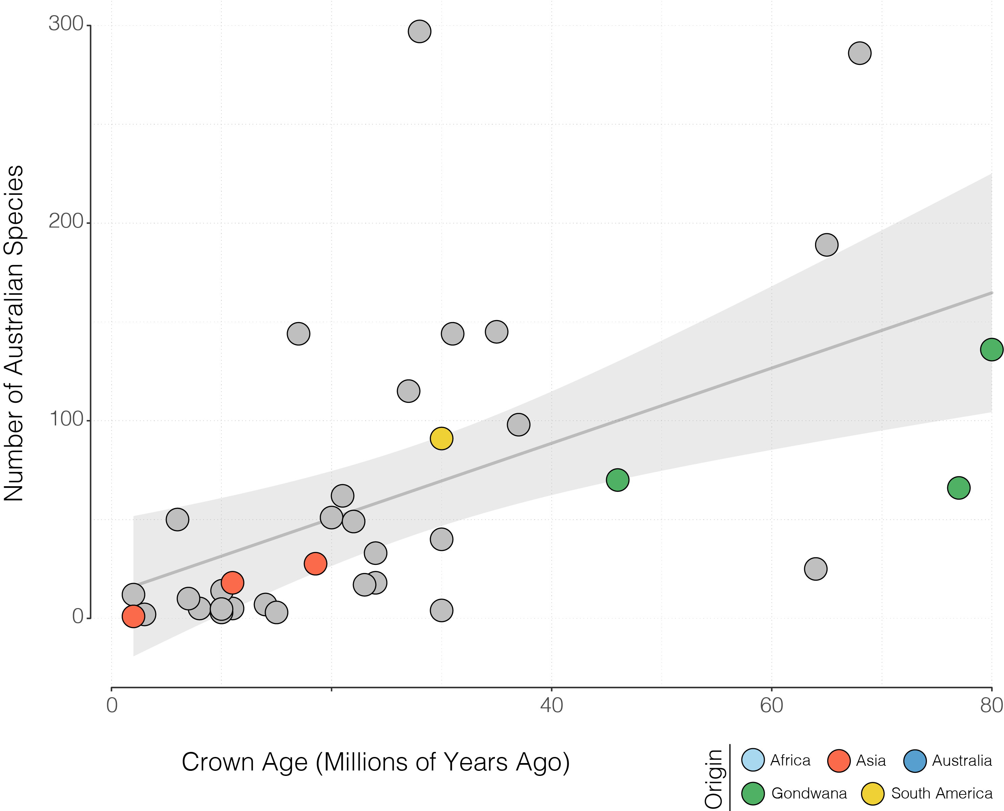

Slide 27
